Slide 1

“Splash”
Solution Showcase

Slide 2
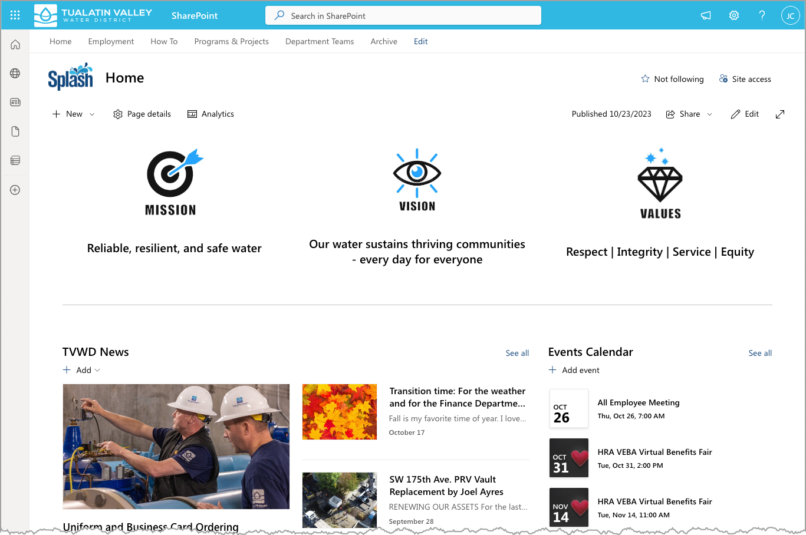
Splash Homepage
Logo = Quick Link to Home
App bar w/ Global Navigation
Mission, Vision, & Values
Latest TVWD News and Announcements
Upcoming Events

Slide 3
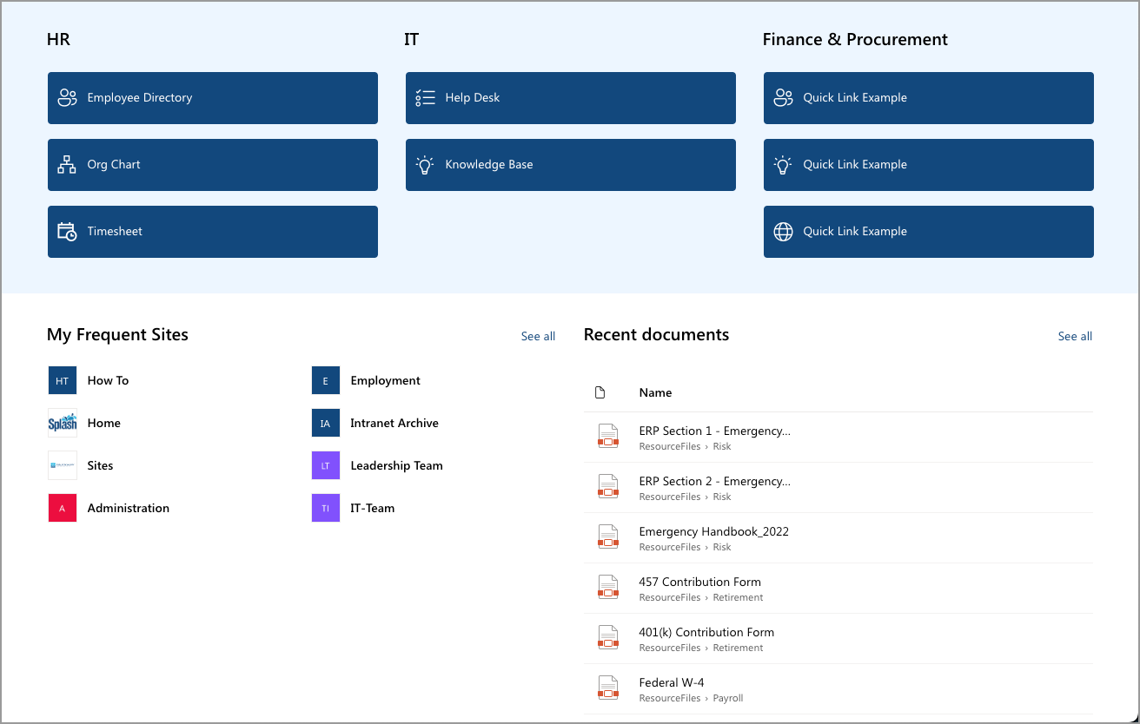
Splash Homepage, cont.
Quick Links to Helpful Resources
Personalize Listing of the Sites You Frequent Most
Personalize Listing of the Files You Opened Recently

Slide 4
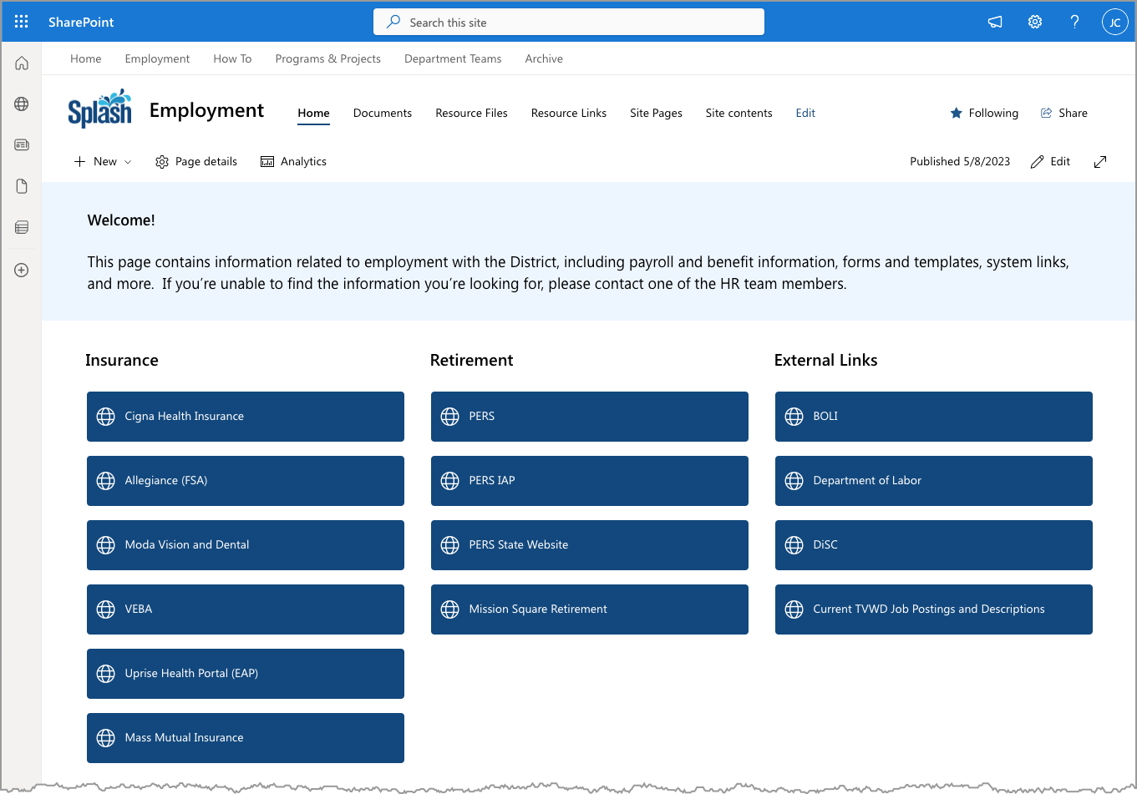
Employment Homepage
Helpful Introduction
Links to Top Employee Resources

Slide 5
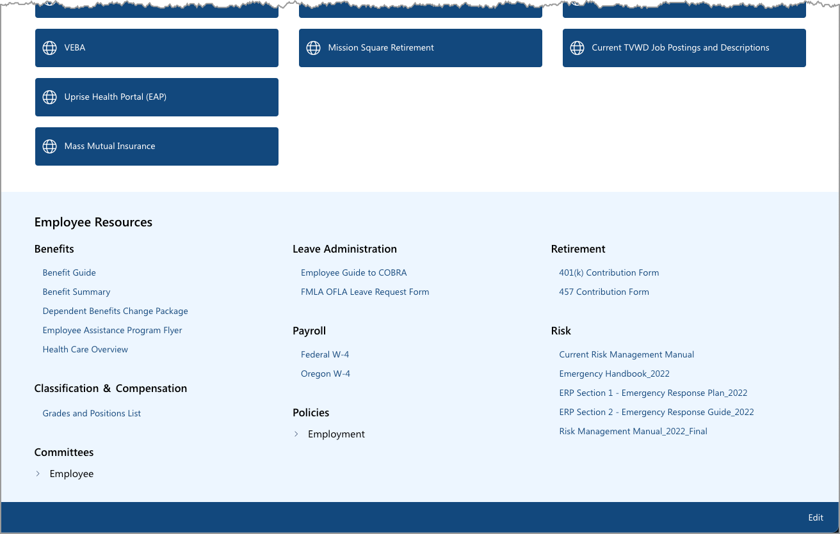
Employment Homepages, cont.
Top Employee Resources
Listings of Employee Resources
Tip: Watch for more added to this list!

Slide 6
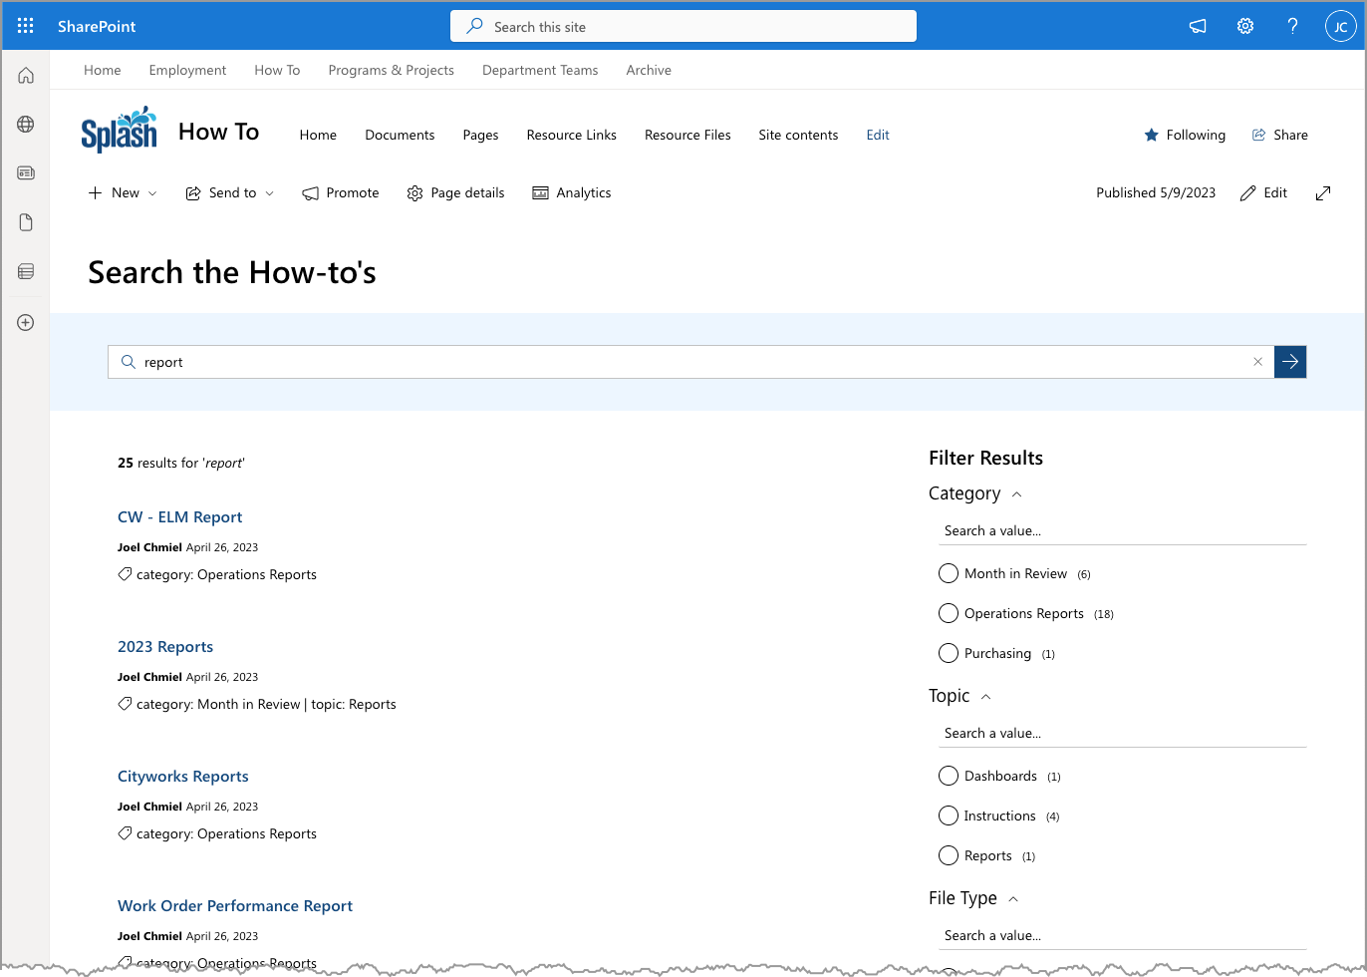
How To Search
You Can Update Your Keyword(s) and Press Enter
You Keyword Search from the Homepage
Filters to Help You Find the Right Results
Results with Details

Slide 7
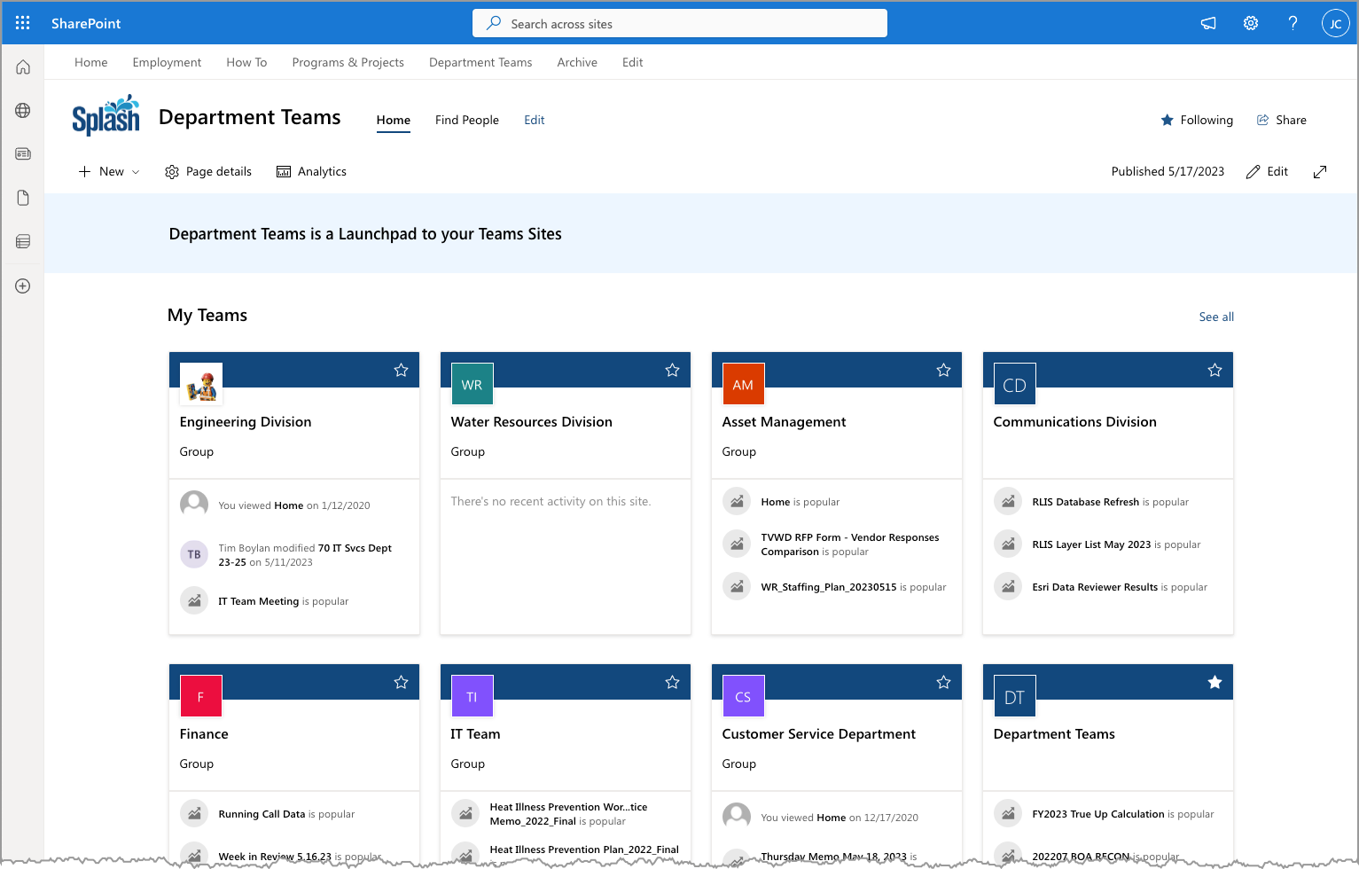
The Department Teams Site
Helpful Introduction
“See all” link: Complete listing of all sites you can access
Listing of Department teams you can access

Slide 8
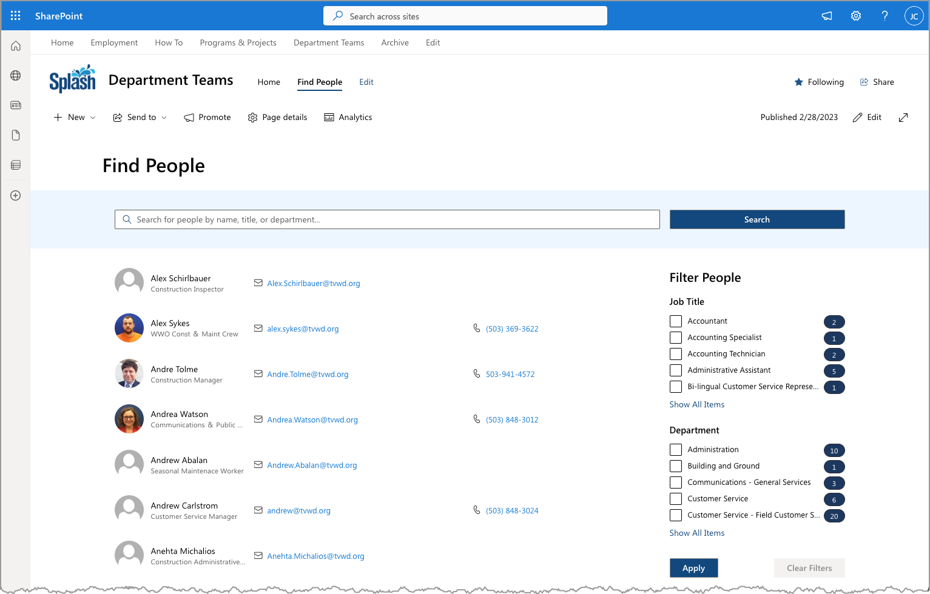
“Find People” Search
You Can Update Your Keyword(s) and Press Enter or “Search”
You Keyword Search for People
Filters to Help You Find the Right Results
People Results with Details

